Slide 1
A Visual Analysis of Video Game Discussions on Stack Overflow
By Jonah Lichtenthal

Slide 2
Introduction/Goals
Goal: Analyze raw data from Stack Overflow posts about video games and derive relevant insights
A snippet of the data is as follows:
Notes:
In the age of ChatGPT, an ongoing debate has been how the use of stack overflow will change when it comes to debugging coding issues as chatgpt is often much more efficient. Our idea is to combine these two mediums to create a powerful tool that leverages the structured knowledge of Stack Overflow with the generative capabilities of ChatGPT.

Slide 3
Stack Overflow Data Dump
This is a dataset of questions, answers, and metadata for analysis from Stack Overflow
371
1,100 MB
8 files
Datasets
Folder Size
Data Files
Containing stack overflow data on different topics
For our specific stack overflow dataset on gaming topics
Datasets come with 8 files: badges, comments, posthistory, postlinks, posts, tags, users, votes

Slide 4
Data Preprocessing Pipeline
Convert XML To CSV
Count Tags
Count how many times each tag appears putting it into a list
Used The ElementTree XML API to convert XML Files to CSV files
01
02
03
04
Download data
Clean Data
Removing nulls and HTML tags

Slide 5
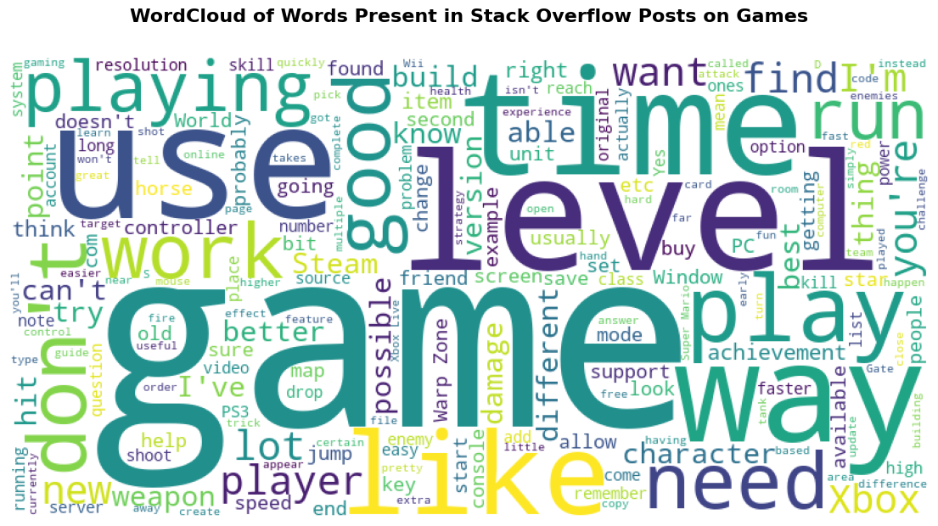
Exploratory Data Analysis

Slide 6
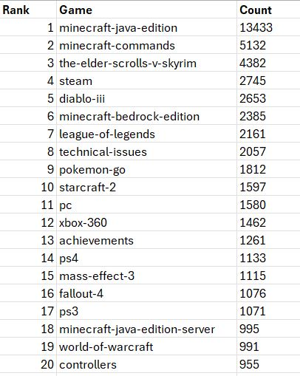
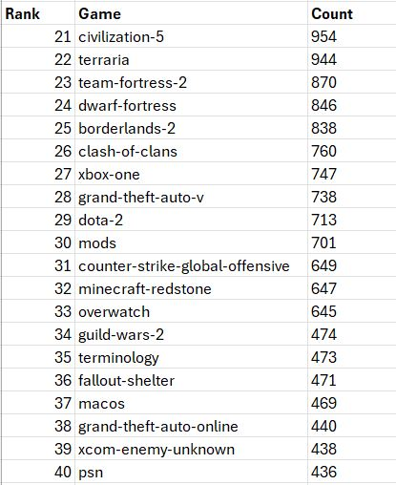
Top 40 Tags In Stack Overflow Gaming Posts

Slide 7
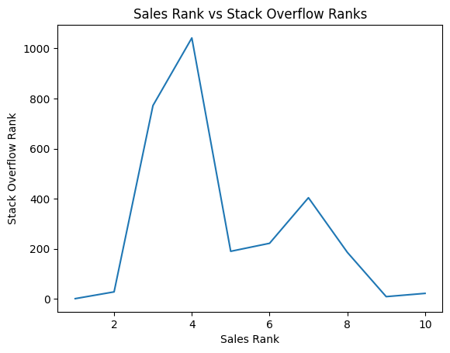
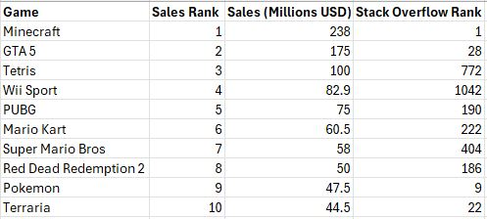
Number of Stack Overflow Tags for Top 10 Best-Selling Games

Slide 8
Conclusions
Games with more development opportunities are more frequently discussed on Stack Overflow. For example, Minecraft appears multiple times in the top 40 due to its extensive modding and in-game mechanics.
Fortnite, despite being more popular today, does not rank in the top 40 because it requires significantly less development effort.
While there is no clear correlation between game sales and Stack Overflow ranking, a more nuanced look shows higher-selling games are still more likely to appear in Stack Overflow discussions. Even a tag ranked 1000th is within the top 20% of all tags.
Further work: Create a website for others to check where their favorite game ranks in stack overflow.

Slide 9
Questions?

Slide 10
Sources
Data: https://archive.org/details/stackexchange\
Games Sales Data: https://scoop.market.us/video-games-statistics/
Code: https://github.com/Jonah-Lichtenthal/Forge-Project

